Slide 1
Development of a feature rich, practical online Tickets reservation system for Multiplex Cinema halls.
A Mini-Project on
Group Members :
Avishek Pant IIT2009134
Raju Khanal IIT2009009
Rakesh Kumar Shah IIT2009018

Slide 2
Project Abstract
This project is to develop an online ticket reservation system for Multiplex Cinema Halls.
The Ticket Reservation System is an Internet based application that can be accessed throughout the Internet and can be accessed by anyone who has a net connection. This application will automate the reservation of tickets and Enquiries about availability of the tickets.
This application includes e-mail/sms confirmation for the tickets.

Slide 3
Functional aspect of Project
User can login to system through Internet
Query for movies
See reservation details made
Able to choose the seats which can are available for a certain class
Give details about the credit card information
Confirmation mail should be sent to user if reservation is done
Get details about fare for corresponding show and payment options

Slide 4
Design of a Project
Use-case Diagram
CRC Diagram
Class Diagram

Slide 5
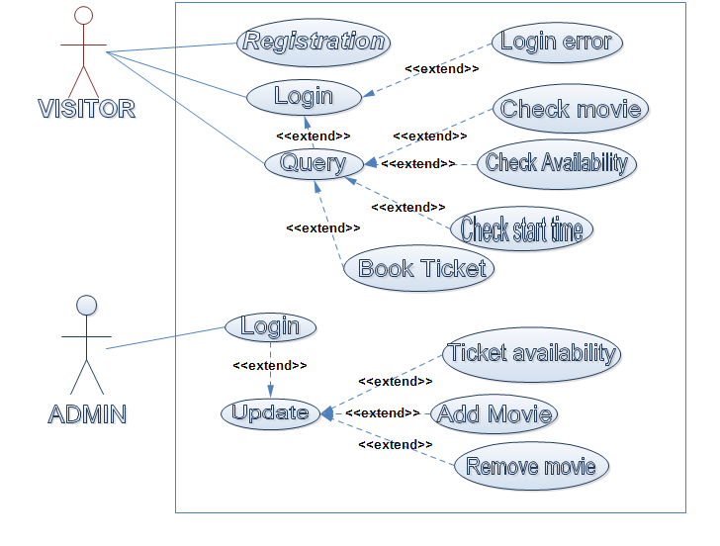
Use Case Diagram

Slide 6
CRC Diagram
CRC for Login
Class: Login
Description: This class contains information for login of user to system.
Responsibilities | Collaborators
Validate login and generate error if username and password do not match with that of system database | User

Slide 7
CRC for User
Class: User
Description: This class contains details of Users.
Responsibilities | Collaborators
Create account View account Update account | Admin
Update account details Show the details of user ( user-id, password, name, address etc.) | Admin
Query for a movie Check for seat availability | Movie Seat Screen
Book ticket Cancel ticket Change show-time | Screen Seat Payment Ticket

Slide 8
CRC for Seat
Class: Seat
Description: This class contains details of seats available for booking in a particular Screen.
Responsibilities | Collaborators
Provide seat details to select specific seat of a class | Screen
Update seat availability | Admin

Slide 9
CRC for Ticket
Class: Ticket
Description: This class contains information for reservation of ticket for a particular Movie.
Responsibilities | Collaborators
Book ticket | Seat Ticket
Cancel Ticket | Seat Ticket

Slide 10
CRC for Movie
Class: Movie
Description: This class contains details of Movie which is scheduled in a particular screen at a particular show-time.
Responsibilities | Collaborators
Schedule new movie Cancel movie Remove movie | Screen Seat
Update movie details | Screen

Slide 11
CRC for Screen
Class: Screen
Description: This class contains details of different screens of a multiplex hall.
Responsibilities | Collaborators
Schedule new movie Remove movie | Admin Movie Seat
Update seat availability | Admin Seat

Slide 12
CRC for Admin
Class: Admin
Description: This class contains details of different administrative roles.
Responsibilities | Collaborators
Schedule new movie Remove movie | Movie Seat
Update seat availability | Seat
Confirm ticket Cancel Ticket | Seat Ticket
Add user Remove user | User Admin

Slide 13
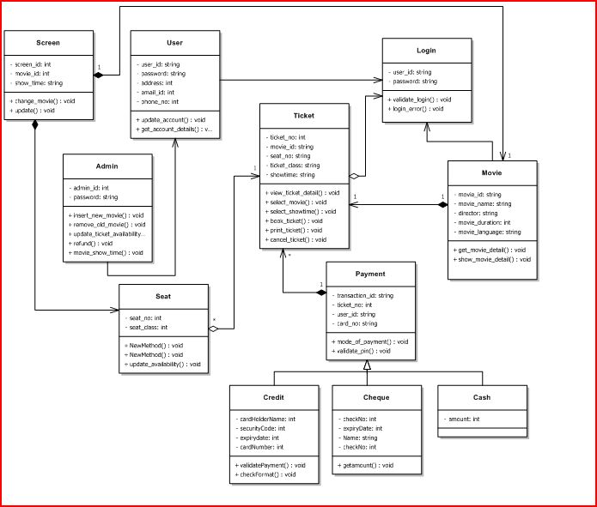

Slide 14
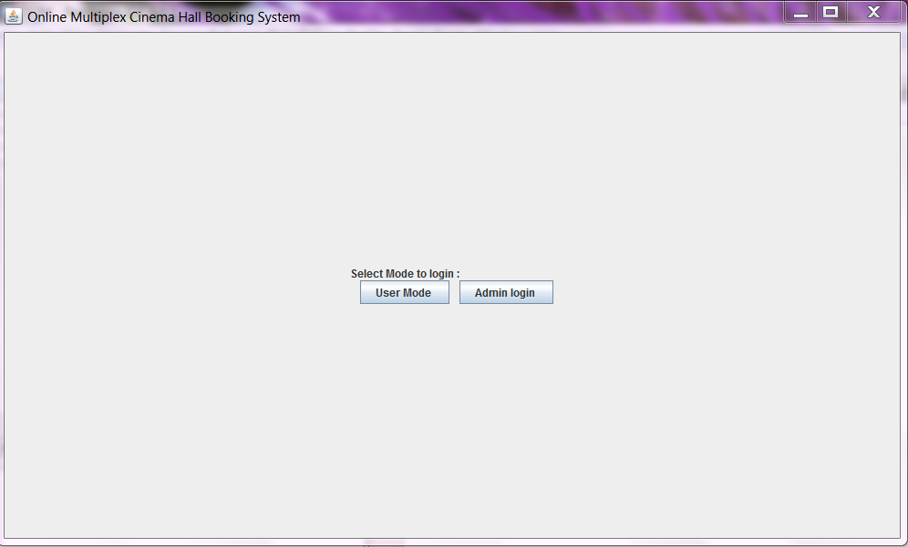
User Interface

Slide 15
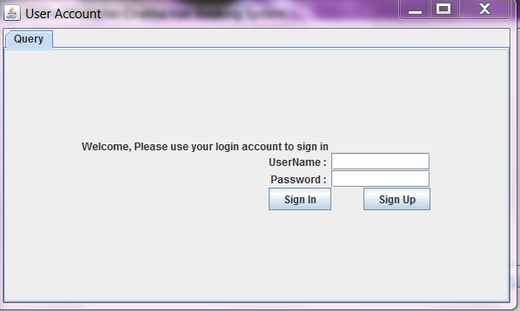

Slide 16
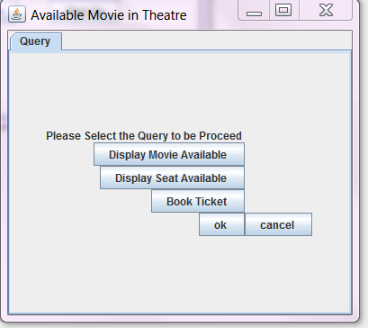

Slide 17
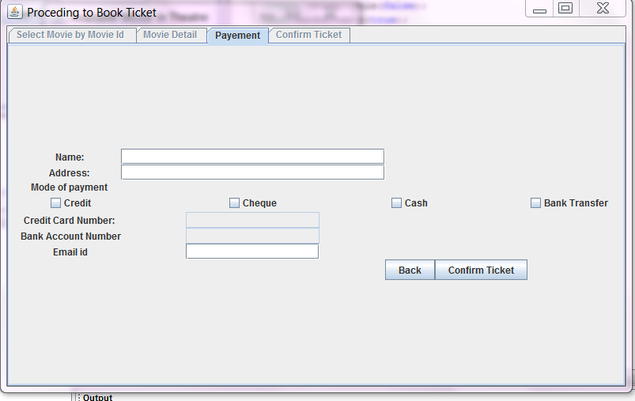

Slide 18
Group Members :
Avishek Pant IIT2009134
Raju Khanal IIT2009009
Rakesh Kumar Shah IIT2009018
Thank you

